Slide 1

Artificial Intelligence Lecture 02: Rational Agents
Farhad Muhammad Riaz

Slide 2
Lecture Outline
Agents and Environments
Rationality
PEAS
(Performance Measure, Environment, Actuators, Sensors)
Environment Types
Agent types

Slide 3
Agents
An agent is anything that can be viewed as perceiving its environment through sensors and acting upon that environment through actuators
Human agent:
Eyes, ears, and other organs for sensors
Hands, legs, mouth, and other body parts for actuators
Robotic agent:
Cameras and infrared range finders for sensors
Various motors for actuators.

Slide 4
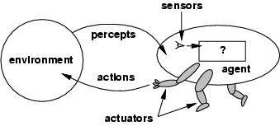
Agents and Environments
The agent function maps from percept histories to actions:
[f: P* → A]
The agent program runs on the physical architecture to produce f
Agent = architecture + program

Slide 5
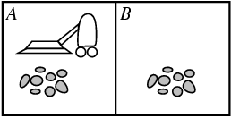
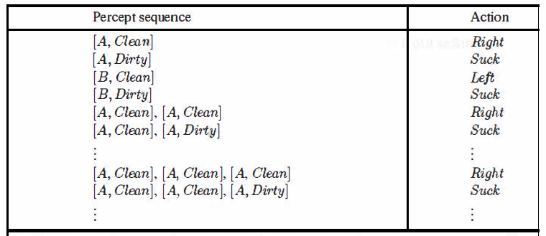
Vacuum-cleaner World
Percepts: location and contents, e.g., [A,Dirty]
Actions: Left, Right, Pick_Dirt, NoOp

Slide 6
Rationality – Performance Measure
An agent should strive to "do the right thing", based on what it can perceive and the actions it can perform
The right action is the one that will cause the agent to be most successful
Performance measure: An objective criterion for success of an agent's behavior
E.g., performance measure of a vacuum-cleaner agent could be amount of dirt cleaned up, amount of time taken, amount of electricity consumed, amount of noise generated, etc.

Slide 7
Rational Agent - Role
Rational Agent: For each possible percept sequence, a rational agent should select an action that is expected to maximize its performance measure, given the evidence provided by the percept sequence and whatever built-in knowledge the agent has
We can also use the term “optimizing the performance measure”.

Slide 8
PEAS
PEAS: Performance measure, Environment, Actuators, Sensors
Must first specify the setting for intelligent agent design
Consider, e.g., the task of designing an automated taxi driver:
Performance measure: Safe, fast, legal, comfortable trip, maximize profits
Environment: Roads, other traffic, pedestrians, customers
Actuators: Steering wheel, accelerator, brake, signal, horn
Sensors: Cameras, sonar, speedometer, GPS, odometer, engine sensors, keyboard.

Slide 9
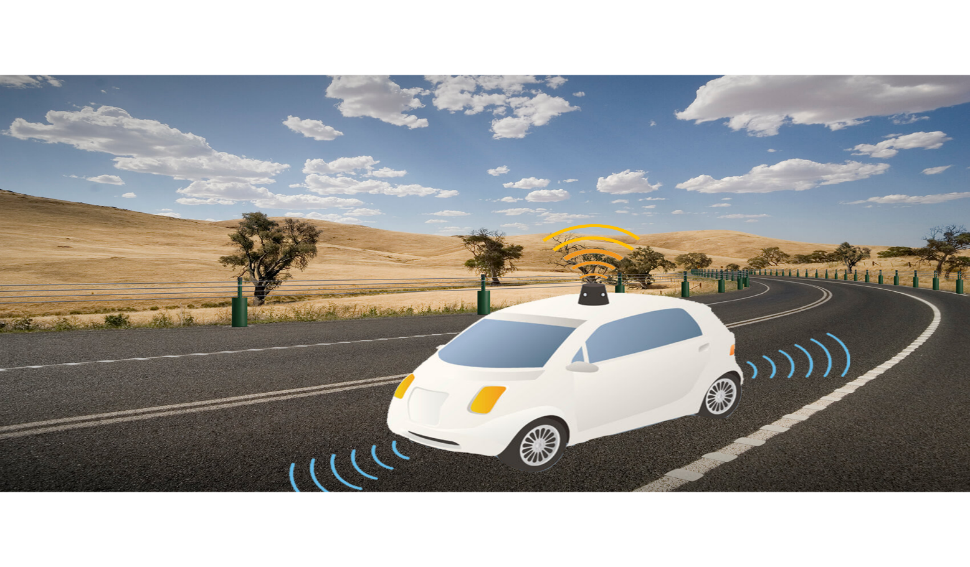
PEAS

Slide 10
Self Driving Car
Performance: Safety, time, legal drive, comfort
Environment: Roads, other vehicles, road signs, pedestrian
Actuators: Steering, accelerator, brake, signal, horn
Sensors: Camera, GPS, speedometer, odometer, accelerometer, sonar.

Slide 11
Medical Diagnosis System
Agent: Medical Diagnosis System
Performance measure: Healthy patient, minimize costs, lawsuits
Environment: Patient, hospital, staff
Actuators: Screen display (questions, tests, diagnoses, treatments, referrals)
Sensors: Keyboard (entry of symptoms, findings, patient's answers).

Slide 12
Interactive English tutor
Agent: Interactive English tutor
Performance measure: Maximize student's score on test
Environment: Set of students
Actuators: Screen display (exercises, suggestions, corrections)
Sensors: Keyboard.

Slide 13
Environment Types
Fully Observable (vs. Partially Observable): An agent's sensors give it access to the complete state of the environment at each point in time
In FO, the agent can be confident that it requires nothing more in order to decide on the optimal action
PO can be due to faulty sensors
If we are driving along a stretch of road that we know well, and if dust enters our eyes, we are still able to drive on the route with blinking eyes (partial observation)
PO requires the agent to have an internal representation of the state.

Slide 14
Environment Types
Deterministic (vs. Stochastic): The next state of the environment is completely determined by the current state and the action executed by the agent
Stochastic (Non-Deterministic): There can be more than one next state, for a given state-action combination
Taxi Driving is clearly stochastic
Consider a Multi-agent environment
If the environment is deterministic except for the actions of other agents, then the environment is strategic
Strategy Games.

Slide 15
Environment Types
Episodic (vs. sequential): The agent's experience is divided into atomic "episodes”
Each episode consists of the agent perceiving and then performing a single action, and the choice of action in each episode depends only on the episode itself, e.g., a robot whose job is to detect faulty parts on a line in some factory
In a sequential setting, the next episode depends on the previous one(s), e.g., learning which chess move to execute at each sequential step, in order to win the game at the end
Also called a sequential decision process.

Slide 16
Environment Types
Static (vs. Dynamic): The environment is unchanged while an agent is deliberating which action to execute
Much more simpler to deal with
For the dynamic case, the agent needs to keep track of the changes
The environment is semi-dynamic if the environment itself does not change with the passage of time but the agent's performance score does, e.g., checkers.
Discrete (vs. Continuous): The environment is discrete if the number of actions and possible states of the environment is finite otherwise it is continuous.

Slide 17
Environment Types
Single Agent (vs. Multi-Agent): An agent operating by itself in an environment
In the multi-agent case, the performance measure of one agent depends on the performance measures of the other agent(s)
Competitive multi-agent: Chess Playing
Collaborative multi-agent: Robo Soccer.
A quite complicated field which is currently the focus of much research.

Slide 18
Agent Functions and Programs
An agent is completely specified by the agent function that maps percept sequences to actions
Can also be labeled as the strategy of the agent
There could be many possible agent functions
Aim: Discover the most rational (optimal) agent function.

Slide 19
Table-lookup Agent
Simplest possible agent function:
All possible states and their optimal actions specified by the designers in advance
Drawbacks:
Huge table (consider continuous states)
Could take a long time to build the table
No autonomy!
Even with learning, agent could need a long time to learn the table entries.

Slide 20
Agent types
Four basic types in order of increasing generality:
Simple Reflex agents
Model-based Reflex agents
Goal-based agents
Utility-based agents
And Finally: Learning agents

